Slide 1

FINANCIAL FORECASTING DASHBOARD USING POWER BI
Jyothi Sravani Kanaparthi

Slide 2
ABSTRACT
This project involves creating a Financial Forecasting Dashboard using Power BI to deliver real-time insights into a company's financial health. By analyzing historical data and market trends, the dashboard uses predictive analytics to forecast revenue, expenses, and profit margins. The goal is to help businesses make better strategic decisions by optimizing resources, improving budget planning, and reducing potential risks.
Through intuitive visualizations, the dashboard simplifies complex financial data, making it easily understandable for stakeholders. Additionally, it sets the foundation for integrating AI-driven predictions and expanding data sources, enhancing its ability to support agile decision-making in a constantly changing financial landscape.

Slide 3
Introduction to Power BI
A business intelligence tool by Microsoft used for interactive data visualization and analytics.
Transforms raw data from various sources into meaningful, actionable insights.
Supports drag-and-drop functionality for creating dashboards, reports, and visualizations.
Integrates seamlessly with tools like Excel, SQL, and cloud services for data import and analysis.
Enables real-time data monitoring and collaboration through sharing and publishing reports.
Offers AI capabilities for advanced analytics, making it easier to identify trends and patterns.
Provides secure data access and governance with role-based permissions for sensitive information.
Supports mobile access, allowing users to view and interact with dashboards on smartphones and tablets.
Facilitates custom visualization development using Power BI SDK for tailored analytics solutions.

Slide 4
Speciality of Power BI
Power Query: Simplifies data extraction, transformation, and loading (ETL) processes from multiple sources.
Power Pivot: Enables advanced data modeling, creating relationships, and performing complex calculations.
Power View: Provides interactive data visualization, allowing users to explore insights in real-time.
Power BI Service: A cloud-based platform for sharing, publishing, and collaborating on reports and dashboards.
Power BI Desktop: A comprehensive desktop tool for building reports, data models, and visual analytics.
DAX (Data Analysis Expressions): A powerful formula language used for data manipulation and custom calculations.
Natural Language Query (Q&A): Lets users explore data using natural language questions for instant insights.
Data Gateway: Ensures secure connectivity between on-premises data sources and the Power BI cloud service.
Power Map (3D Maps): Allows for geospatial data visualization, turning data into interactive 3D maps.
AI Insights: Leverages machine learning models for predictive analytics, anomaly detection, and sentiment analysis.

Slide 5

Definition of Financial forecasting
Predictive Analysis: The process of estimating future financial outcomes based on historical data, trends, and market conditions.
Strategic Planning Tool: Helps organizations make informed business decisions related to budgeting, investments, and growth opportunities.
Risk Management: Identifies potential financial risks, allowing businesses to mitigate losses and adjust strategies proactively.
Revenue & Expense Estimation: Provides accurate forecasts of income, expenses, and cash flow, ensuring effective resource allocation.
Scenario Analysis: Uses various economic scenarios to evaluate best-case and worst-case outcomes for strategic decision-making.
Performance Monitoring: Enables continuous tracking of financial performance to align business objectives with market dynamics.

Slide 6
Steps to Create a Financial Forecasting Dashboard in Power BI:
Import Data
Data Cleaning and Transformation
Create Forecasting Visualizations
Add KPIs and Metrics
Design the Dashboard
Incorporate Scenario Analysis
Automate Data Refresh
Implement Security Settings
Publish and Share
Gather Feedback and Optimize

Slide 7
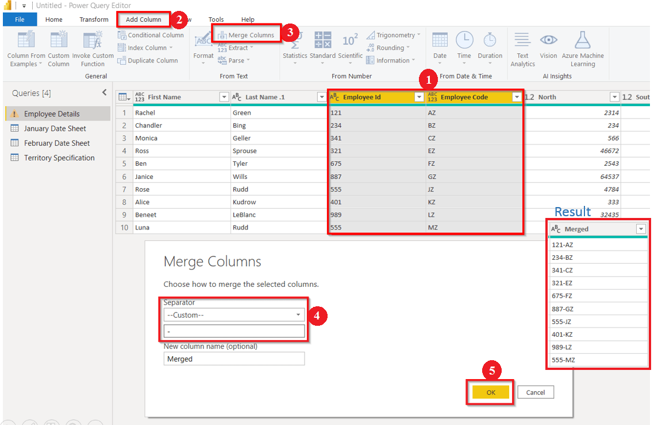
Transformation of data

Slide 8
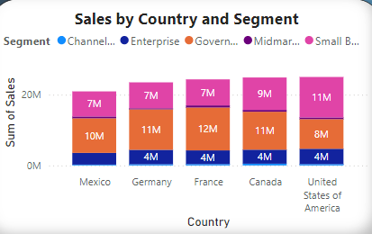
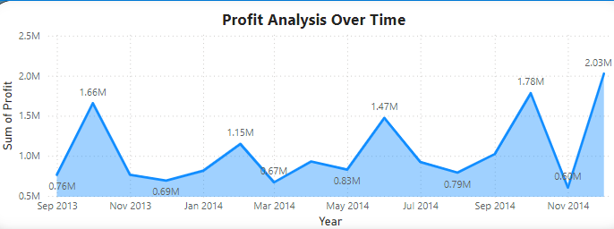
Visualizations
The stacked column chart shows sales by country and segment, with each column representing a country and stacked sections indicating segment contributions. It helps identify top-performing segments and countries.
The line chart tracks profit trends over time, helping visualize fluctuations and growth. It highlights periods of high or low profitability, providing insights into seasonal patterns and overall performance.

Slide 9
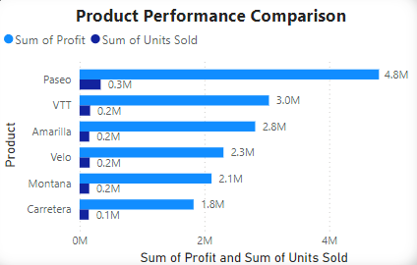
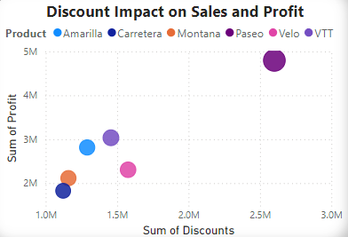
The cluster bar chart compares product performance across different metrics, with grouped bars representing each product. It allows easy comparison of sales or profit, helping identify top-performing products.
The scatter chart analyzes the relationship between discount rates and both sales and profit. It helps identify the optimal discount strategy by showing how different discount levels impact revenue and profitability.

Slide 10
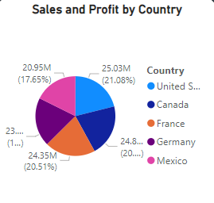
The pie chart displays the distribution of sales and profit by country. It visually highlights the market share and profitability of each country, making it easy to identify key contributors to overall performance.

Slide 11
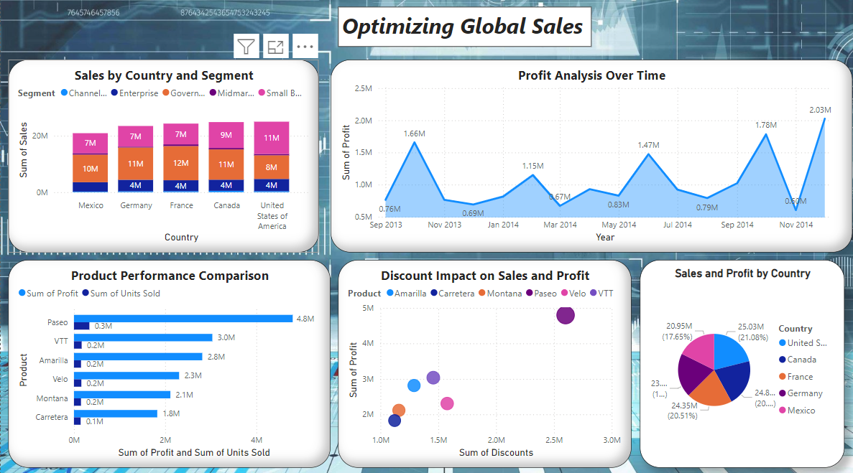
DASHBOARD-1

Slide 12
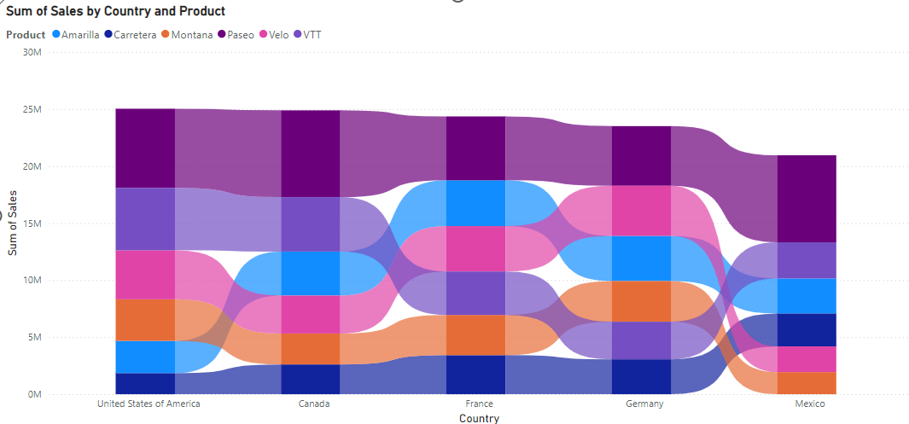
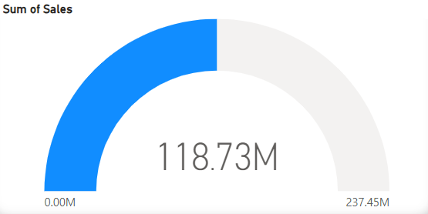
Visualizations
The ribbon chart visualizes the count of countries segmented by sales and products. It highlights changes in rankings over time, showing which products perform best in different countries. The chart’s ribbons connect data points, making it easy to track shifts in product demand and identify top markets.
The gauge chart displays the sum of sales relative to a set target, using a needle to show progress. It offers a quick, visual snapshot of how close current sales are to reaching the goal, making it ideal for tracking overall performance and hitting key sales targets.

Slide 13
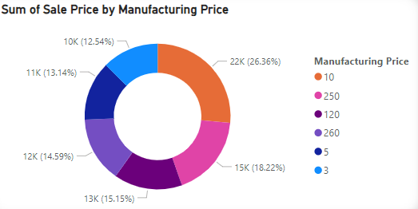
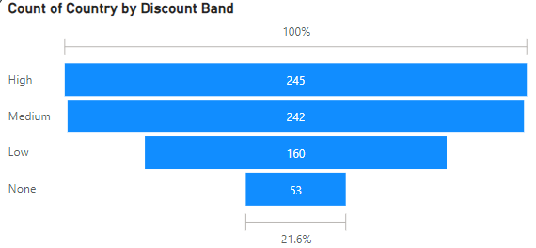
The donut chart illustrates the sum of sale prices compared to manufacturing costs. The segmented circular design makes it easy to see how sales prices are distributed relative to costs, helping to assess pricing efficiency and profitability.
The funnel chart visualizes the count of countries by discount band, with each segment representing a different discount level. The chart narrows down to show how countries distribute across various discount ranges, making it easy to identify which discount bands are most effective in different markets.

Slide 14
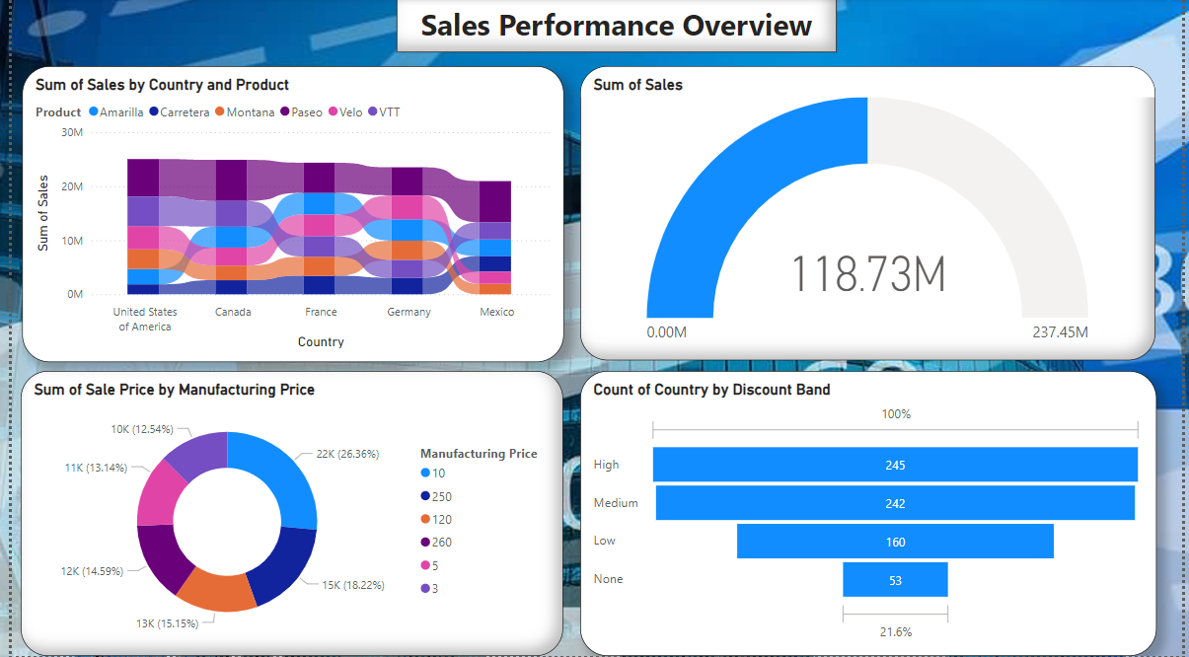


Slide 15

Conclusion
The Financial Forecasting Dashboard developed using Power BI enables businesses to leverage data-driven insights for effective financial management. By visualizing critical metrics, companies can optimize resources, forecast accurately, and enhance decision-making processes. This project demonstrates the power of BI tools in transforming raw data into strategic assets, laying the groundwork for future advancements in predictive analytics and AI integration.

Slide 16

THANK YOU

